Slide 1
Introduction to Angular
Tushar Raj
Gaurav Sharma

Slide 2
Introduction
Angular is a front-end framework created and actively maintained by a team at Google.
Since it is a framework (as opposed to a library like React), Angular has much more features and functionality, but it also means it has its own philosophy about design patterns and structuring. And a greater learning curve.
It is one of the most popular frameworks today. Companies that use it include Google, Microsoft, Paypal, Forbes, HBO and Sony.

Slide 3
Version History
Angular 2, released in 2016, was a ground-up rewrite of AngularJS, released earlier by the same team in 2010.
To avoid confusion, the team refers to the earlier 1.x versions as AngularJS and versions 2 and above as simply Angular.
AngularJS took more of an MV* approach. Angular (2+) was significantly different. It was virtually a new framework.
Angular does new major releases twice a year. The latest version is Angular 8 released on May 28, 2019.

Slide 4
Overview
Part 1: Basics
Prerequisites, Bootstrapping and introduction to components
Part 2: Component Interaction
@Input, @Output and services
Part 3: Modules
Routing, Forms and HTTP modules

Slide 5
Component-Based Architecture
The whole application is a tree of components.
Components are self-contained and reusable.
Components are composable: one component can be made up of one or more instances of one or several components.
Angular loads only the components needed for the current display.

Slide 6
Prerequisites
Typescript
“Typescript is a typed superset of JS that compiles to plain JS”
RxJS
RxJS (Reactive Extensions for JavaScript) is a library for reactive programming using observables that makes it easier to compose asynchronous or callback-based code.

Slide 7
Angular CLI
Angular CLI is a command line interface that speeds up development by automating significant parts of the workflow.
You’ll need the latest versions of node and npm on your machine
To install CLI, run:
npm install –g @angular/cli
To create a new app:
ng new project-name
cd project-name
ng serve
The app will run on https://localhost:4200 by default

Slide 8
CLI workspace
Some of the notable files:
Angular.json
src/index.html
src/app/app.module.ts

Slide 9
First Component

Slide 10
Template Syntax
Interpolation {{}}
Property Binding []
Event Binding ()
Two-way Binding [()]

Slide 11
Interpolation
The text between the braces is a template expression that Angular first evaluates and then converts to a string.
You can't use JavaScript expressions that have or promote side effects, including:
Assignments (=, +=, -=, ...)
Operators such as new, typeof, instanceof, etc.
Chaining expressions with ; or ,
The increment and decrement operators ++ and --
No support for the bitwise operators such as | and &
New template expression operators, such as |, ?. and !

Slide 12
Property Binding
HTML attribute vs. DOM property:
Attributes are defined by HTML. Properties are accessed from DOM (Document Object Model) nodes.
Angular doesn’t manipulate HTML attributes, it manipulates DOM properties because the DOM is what actually gets displayed.
The property that is bound could be that of the element, or it could be a custom property defined on the component.
Angular does not allow HTML with script tags to leak into the browser, neither with interpolation nor property binding.

Slide 13
Event Binding
<button (click)="onClick()"> Click me </button>
The $event parameter can be used to access the event object.

Slide 14
Two-way binding
[()] – Banana-in-a-box syntax
Any update in the UI updates the model too, and vice-versa.
Very useful in forms.
One of the USPs of Angular when it first came out.

Slide 15
Class and Style Bindings
Class binding
<div class="blue" [class.red]="!isValid">
Style binding
<button [style.background-color]="hasError?'red':'green' ">
NgClass
NgStyle

Slide 16
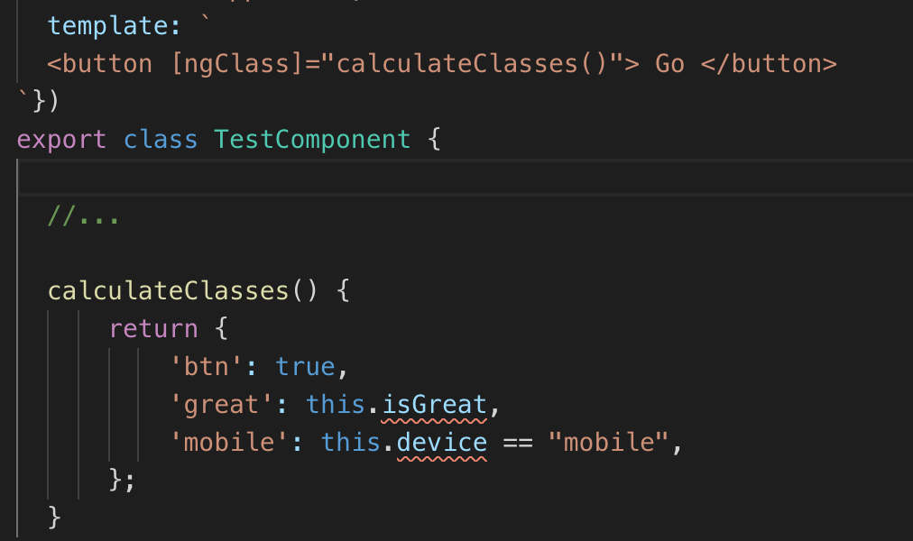
NgClass

Slide 17
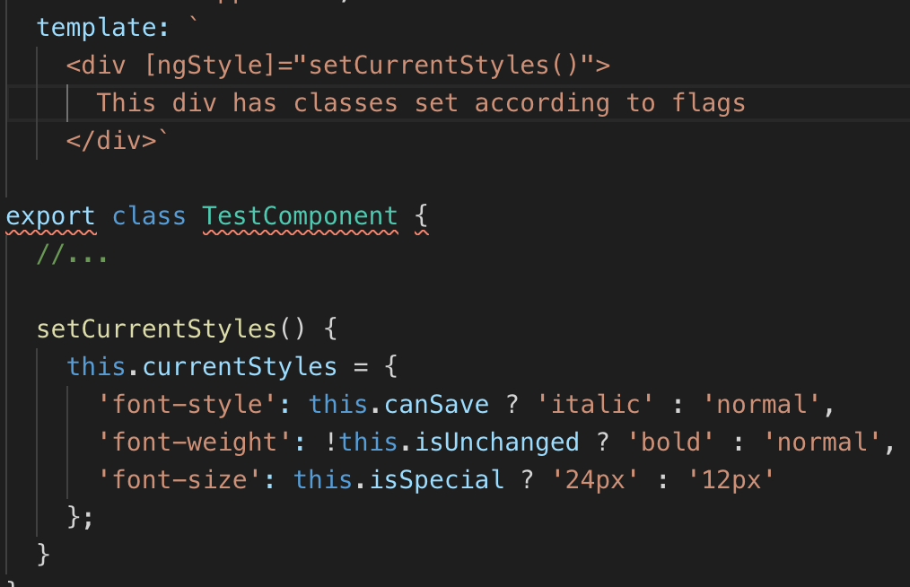
NgStyle

Slide 18
Structural Directives
Structural directives are responsible for HTML layout. They shape or reshape the DOM's structure, typically by adding, removing, and manipulating the host elements to which they are attached.
Common built-in structural directives:
*ngIf — conditionally creates or destroys subviews from the template.
*ngFor — repeat a node for each item in a list.
[ngSwitch] — a set of directives that switch among alternative views.

Slide 19
Attribute Directives
Attribute directives listen to and modify the behavior of other HTML elements, attributes, properties, and components. You usually apply them to elements as if they were HTML attributes, hence the name.
The most common attribute directives are as follows:
[ngClass] — adds and removes a set of CSS classes.
[ngStyle] — adds and removes a set of HTML styles.
[(ngModel)] — adds two-way data binding to an HTML form element.

Slide 20
Template expression operators
The Angular template expression language employs a subset of JavaScript syntax supplemented with a few special operators for specific scenarios:
The pipe operator (|)
The safe navigation operator ( ? )

Slide 21
Pipes
Pipes are used in template expressions to transform data before showing it to users.
Built-in pipes:
Lowercase
Uppercase
Percent
Currency
Date
Pipes can be chained.

Slide 22
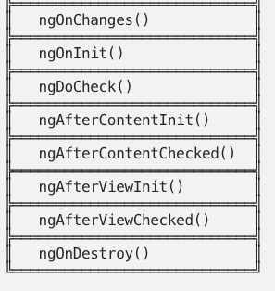
Lifecycle hooks

Slide 23
Angular style guide
kebab-case
feature.type.ts
LIFT:
Locate
Identify
Flat folder structure
Try to be DRY

Slide 24
Resources
TypeScript in 5 minutes
https://www.typescriptlang.org/docs/handbook/typescript-in-5-minutes.html
Starting an Angular App with Angular CLI in a couple of minutes
https://scotch.io/courses/build-your-first-angular-website/starting-an-angular-app-with-the-angular-cli
Angular CLI — Demystifying the workspace
https://blog.nrwl.io/angular-cli-demystifying-the-workspace-7f59ffaab4cb

Slide 25
Further Reading
Setting Up Angular from Scratch (No CLI)
https://blog.angularindepth.com/setting-up-angular-from-scratch-1f518c65d8ab
Angular ngClass and ngStyle: The Complete Guide
https://blog.angular-university.io/angular-ngclass-ngstyle/
Angular ng-template, ng-container and ngTemplateOutlet
https://blog.angular-university.io/angular-ng-template-ng-container-ngtemplateoutlet/

